Slide 1




University Online
Admission System
(Web-Based Software)

Slide 2

Project Team Members :
MD.RAKIBUL HASAN RAKIB
ID : UG02-59-22-002
MD.MUSTAFIZUR RAHMAN
ID : UG02-59-22-019
RAKIB HOSSAIN POROSH
ID : UG02-59-22-020

Slide 3
Introduction :
This project proposes an Online Admission System that enables students to apply for admission to the University through a secure and user-friendly web platform. The system will smooth the admission process, reduce paperwork, minimize errors, and provide an efficient management dashboard for university staff.

Slide 4







Objectives :
Enable students to apply online from anywhere.
To reduce paperwork and administrative overhead.
To ensure accurate data storage and reduce human error.
Integrate an online payment gateway for application fees
Build an admin dashboard for managing and reviewing applications.
To provide applicants with real-time status updates and notifications.

Slide 5
Features :
Student Portal
Account Registration and Login.
Admission Form Submission.
Upload Academic Documents.
Online Payment.
Track Application Status.
Admin Portal
Secure Login.
View and Manage Applications.
Filter and Search Records.
Send Notification to Applicants.
Generate PDF and Excel Reports.
Faculty Portal
Faculty will be able to overview appliations and view student lists.

Slide 6
Tools and Technologies :
Frontend
Database
HTML
CSS
Bootstrap
JS or React
MySQL
Backend
APIs
PHP
Laravel
Email or
SMS
Payment

Slide 7
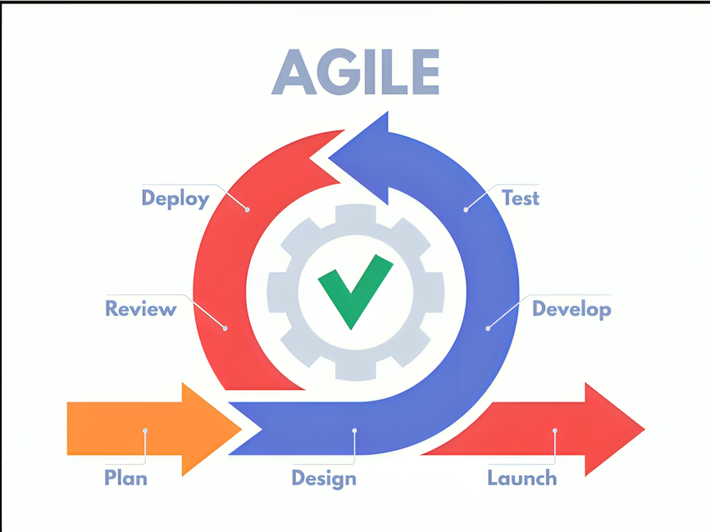
Method :
Agile Method is a way of building software step-by-step. Instead of doing everything at once, work is done in small parts (called sprints) and improved over time based on feedback.
Why Using Agile:
Flexible changes – You can update features anytime based on user needs.
Fast delivery – You release a basic version quickly, then improve it.
Better teamwork – Everyone (developer, designer, client) stays connected.
Customer feedback – You get real feedback early and improve faster.

Slide 8
Positive Social Impacts :
Students from rural areas can easily apply without any hassle.
Faster communication between university and students.
Staff can focus on quality tasks rather than manual paperwork.
Less paper use, saving trees.
Reduces transport, lowering fuel use and pollution.
Less need for printing, saving ink and electricity.
Eco-friendly digital process replaces wasteful manual system.

Slide 9
Working Hour :
Time duration to build the system - 5 months.
The system will be built every month - 22 days
The system will be built every day - 2 hours
The working hours of each person are - (5x22x2) = 220 hours.
So,
The total number of hours a team works together is - (220*3) = 660 hours.

Slide 10




Costing :
Server
Manpower Cost - 100 tk/hour
Total working hour - 220 hours/person
Team working hour - 220x3 = 660 hours
Total Manpower cost - 660x100 = 66,000/-
Domain
Manpower
APIs

Slide 11
Costing :
Total Manpower cost - 66,000/-
Server
Server or Hosting cost - 7,000/-
Domain
Manpower
APIs

Slide 12
Costing :
Server
Total Manpower cost - 66,000/-
Manpower
Server or Hosting cost - 7,000/-
Domain
Domain cost - 2,000/-
APIs

Slide 13
Costing :
Server
Total Manpower cost - 66,000/-
Server or Hosting cost - 7,000/-
Manpower
bkash or Card APIs - 4,000/-
Domain cost - 2,000/-
Domain
Email APIs - 1,000/-
APIs

Slide 14
Costing :
Server
Total Manpower cost - 66,000/-
Server or Hosting cost - 7,000/- (Yearly)
Domain
Domain cost - 2,000/- (Yearly)
Manpower
bkash or Card APIs - 4,000/-
Email APIs - 1,000/- (Monthly)
APIs
Total cost - 80,000/-

Slide 15
Gantt Chart :
Activities | Working Week
 | 1W | 1W | 1W | 4W |  |  |  | 5W |  |  |  |  | 5W |  |  |  |  | 2W |  | 1W
Requirement Gethering
Planning and Prototype Design
UI/UX Design
Frontend Design
Backend Design & APIs Integration
Database Connection
Testing
Deployment & Documentation

Slide 16
Conclusion :
The Online Admission System will make the admission process faster, easier, and more transparent. It supports digital progress and meets the needs of today’s students.

Slide 17
THANK YOU

